Slide 1
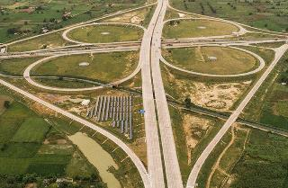
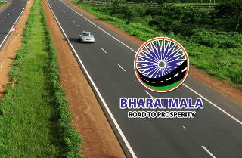
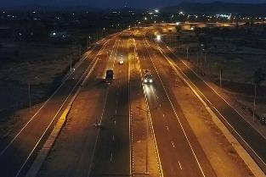
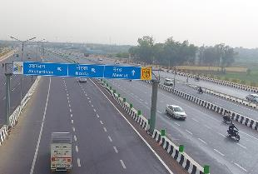
Convergence of Government Program – 1 : Connectivity and Infrastructure – Road connectivity to the destinations
29th March 2023

Slide 2
Agenda
Providing Connectivity to Tourist Destinations
Development of WSAs

Slide 3
Providing Connectivity to Tourist Destinations
01

Slide 4
Projects Completed/ Being Undertaken by MoRT&H in 50 tourist destinations (Phase – 1)
Length (km)>>
3,111
1,209
980
922
Cost (INR Cr.)>>
74,353
15,447
35,447
23,459
Total Projects Connecting to Tourist Destinations
Completed Projects
Ongoing Projects
Balance for Award Projects
State-wise Projects:
M/o Tourism Letter:

Slide 5
Projects Completed/ Being Undertaken by MoRT&H in 50 tourist destinations (Phase – 2)
Length (km)>>
3,727
1,118
1,677
931
Cost (INR Cr.)>>
63,853
8,163
36,129
19,561
Total Projects Connecting to Tourist Destinations
Completed Projects
Ongoing Projects
Balance for Award Projects
State-wise Projects:
M/o Tourism Letter:

Slide 6
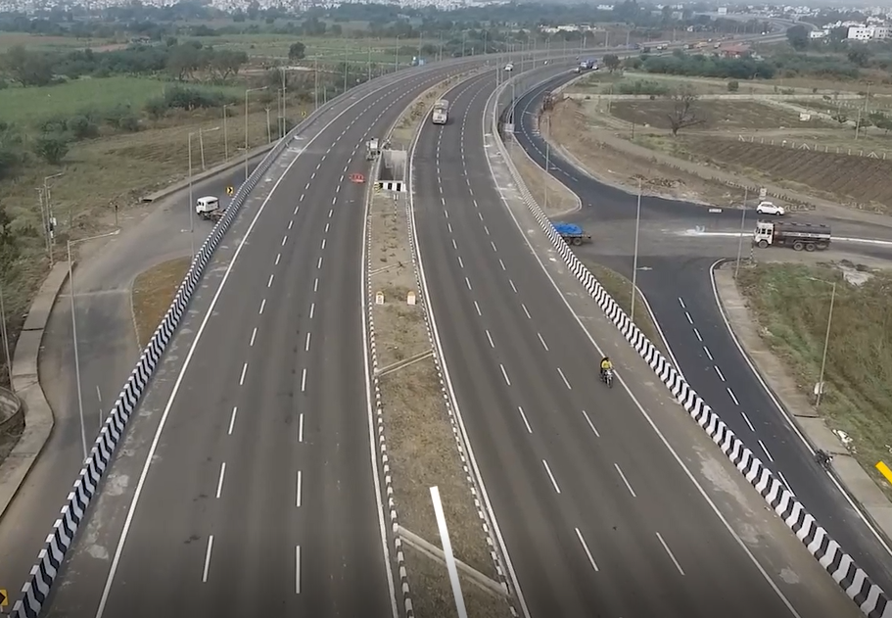
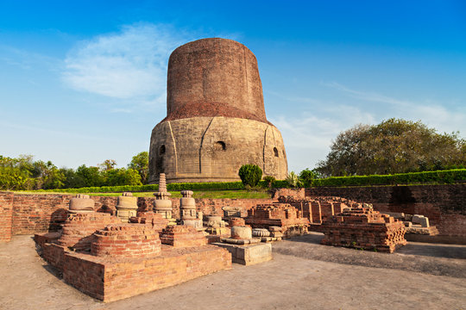
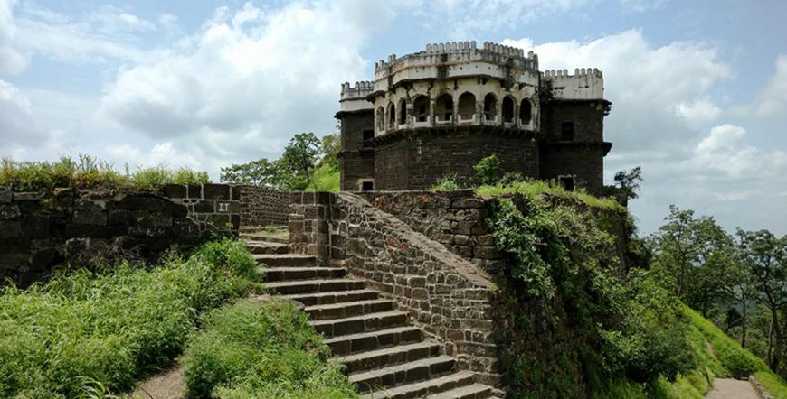
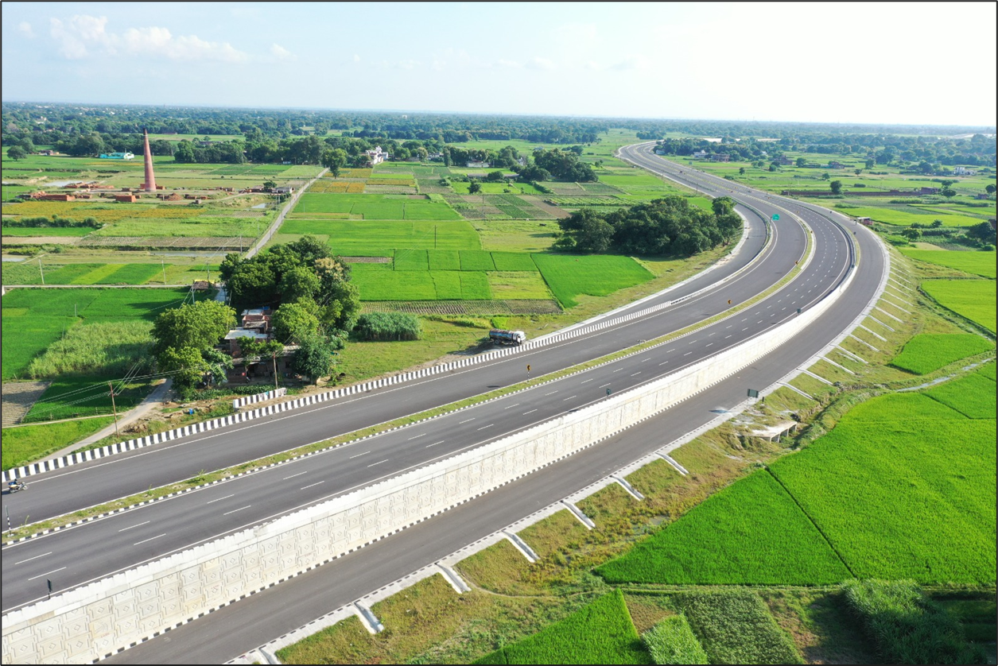
Sample projects of MoRT&H providing connectivity to major tourist destinations
Connectivity to Daulatabad Fort:
Direct connectivity to NH-52 (Completed on 1st Feb 2022)
Connectivity to Sarnath: Varanasi Ring Road (NH-31, BM-I¹) only 1.5km away (Completed on 24th Jan 2022)
1. BM-I – Bharatmala Pariyojana Phase I

Slide 7
Development of Way Side Amenities
02

Slide 8
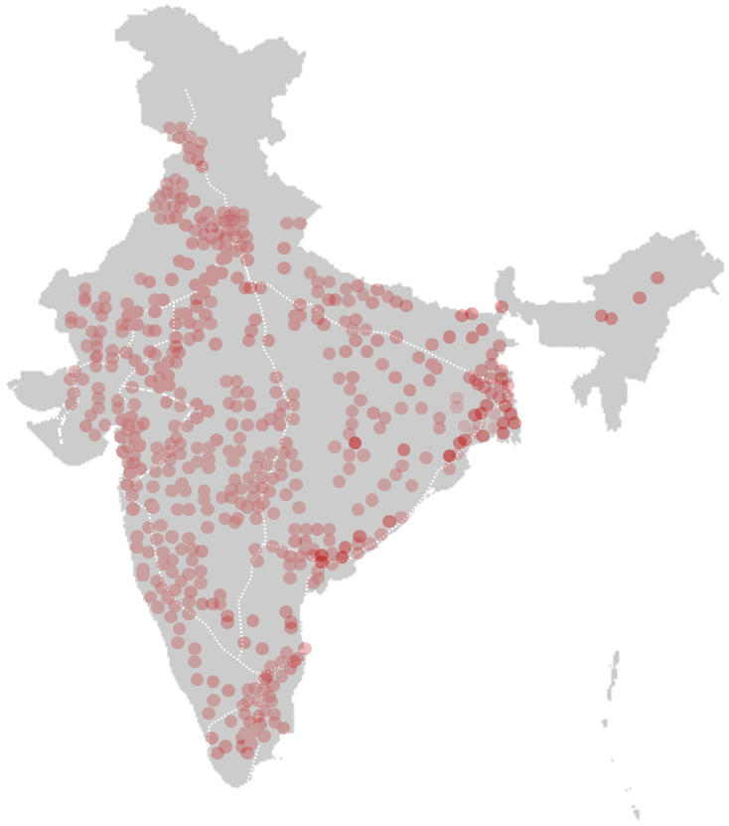
Development opportunity across India – ~600 WSA sites
246
Brownfield Sites
347
Greenfield Sites
Proposed Sites for Development of WSA
Till date, 156 sites awarded for development of WSAs, of which 38 have been operationalized

Slide 9
Mandatory & Permissible Facilities in Way Side Amenities
Mandatory Facilities
Permissible Facilities
Passenger Car Amenity
Trucker’s Amenity
Site Development
Food Court, Kiosks, Restaurants
Convenience Store/Shops
Toilet / Washroom Facility
Drinking Water
Parking (4W & Bus) & EV Charge Station
Children’s Play area
Village Haat
Fuel Station
Medical Facility/ Pharmacy/ Baby care, ATM facility
Emergency Room/ Care Center
Car Mechanic/ Car Wash
Motel/Convention Centre
Dhabas for Truckers
Convenience Store/Shops
Toilet / Washroom Facility
Drinking Water
Truck Parking & EV Chargnig
Village Haat
Fuel Station
Medical Facility/ Pharmacy, ATM
Dormitory for Drivers
Car Mechanic/ Car Wash
Self Laundry & Cooking facility for Truckers
Vehicle Repair Shop
Landscaping
Open Gym & Open rest area with benches and tables
High Mast Lightings
Entry / Exit markings
Road markings
Signage's (Emergency & Advertisement)
24X7 Security / Camera’s
Emergency Room

Slide 10
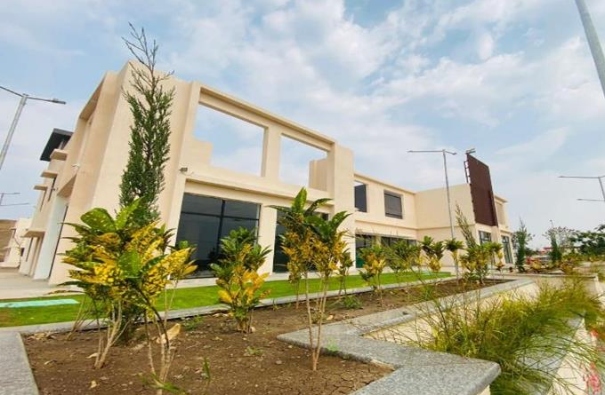
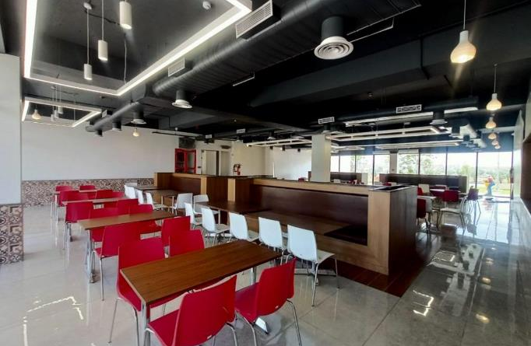
Operationalized WSA at Indore, Madhya Pradesh
Standard Layouts:
Developer: Cube Highways Ltd.
Location: Km 63+300 (RHS) of NH-52 (old NH-3) of Indore - Khalghat, Dhar District, Madhya Pradesh (at Sankota)
Site Area: 1 Ha.
Exterior View
Restaurant
Toilets
Dormitory

Slide 11
Roles and Responsibilities of Different Parties
Bidding Parameters:
Authority
Private Party
Access permission for land parcels
Provision of encumbrance free land
Approval of construction and development plan shared by private party for unconstructed brownfield sites
Monitor development and operations of WSA
Funds for establishment of WSA
Design, construction and development of WSA including Operations & Maintenance
30 years lease: Construction and commencement of operations on brownfield sites withing 10 months of contract signing
15 years lease: Operationalization of constructed facilities within 8 months of signing of lease agreement
Obtaining clearance and approval from concerned Authority for operationalization
Maintain and operate WSA as per industry standard

Slide 13
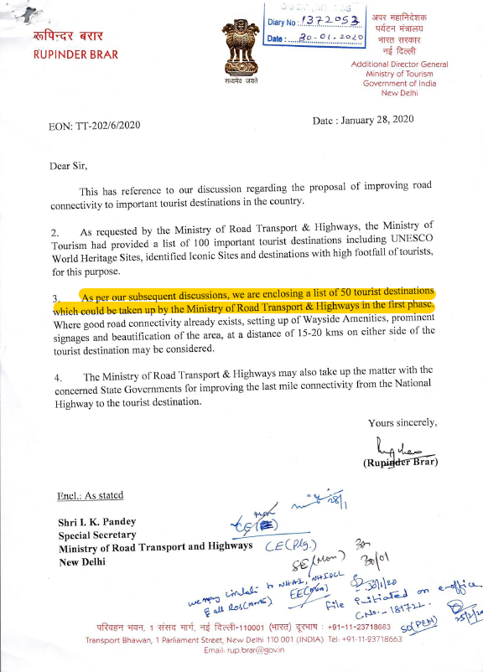
Letter received from Ministry of Tourism on 28th January 2020 with regards to 50 tourist destinations

Slide 14
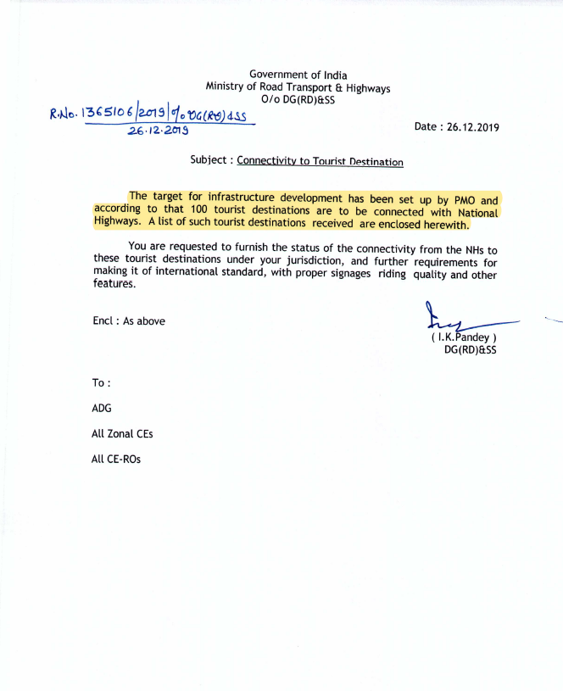
Letter received from Ministry of Tourism on 26th December 2019 with regards to 100 tourist destinations

Slide 15
State-wise distribution of MoRT&H projects aiding tourism – Phase 1 tourist destinations (1/2)
S. No. | Name of State | No. of Completed Projects | No. of Ongoing Projects | No. of BFA Projects
1. | Andhra Pradesh | 1 | 1 | 2
2. | Arunachal Pradesh | 2 | 2 | 0
3. | Assam | 1 | 1 | 0
4. | Bihar | 0 | 4 | 1
5. | Chandigarh | 0 | 0 | 2
6. | Chhattisgarh | 0 | 1 | 3
7. | Daman & Diu | 0 | 1 | 0
8. | Gujarat | 0 | 2 | 1
9. | Haryana | 1 | 0 | 0
10. | Himachal Pradesh | 0 | 1 | 0
11. | J&K | 0 | 2 | 0
12 | Karnataka | 0 | 1 | 0
13. | Kerala | 0 | 3 | 1
14. | Madhya Pradesh | 1 | 1 | 5
15. | Maharashtra | 1 | 0 | 0
16. | Manipur | 3 | 0 | 0
17. | Meghalaya | 1 | 0 | 0

Slide 16
State-wise distribution of MoRT&H projects aiding tourism – Phase 1 tourist destinations (2/2)
S. No. | Name of State | No. of Completed Projects | No. of Ongoing Projects | No. of BFA Projects
18. | Mizoram | 0 | 5 | 0
19. | Nagaland | 1 | 0 | 1
20. | Odisha | 1 | 2 | 1
21. | Rajasthan | 2 | 0 | 0
22. | Sikkim | 3 | 2 | 0
23. | Tamil Nadu | 1 | 3 | 1
24. | Telangana | 0 | 0 | 2
25. | Tripura | 3 | 0 | 0
26. | Uttar Pradesh | 4 | 1 | 0
27. | West Bengal | 9 | 3 | 6
Total | Total | 35 | 36 | 26

Slide 17
State-wise distribution of MoRT&H projects aiding tourism – Phase 2 tourist destinations (1/2)
S. No. | Name of State | No. of Completed Projects | No. of Ongoing Projects | No. of BFA Projects
1. | Andhra Pradesh | 1 | 2 | 2
2. | Assam | 2 | 4 | 3
3. | Bihar | 0 | 2 | 2
4. | Gujarat | 0 | 5 | 1
5. | Haryana | 0 | 1 | 0
6. | Himachal Pradesh | 4 | 1 | 0
7. | Himachal Pradesh | 0 | 0 | 1
8. | Karnataka | 2 | 2 | 0
9. | Kerala | 0 | 1 | 0
10. | Madhya Pradesh | 2 | 0 | 0
11. | Maharashtra | 1 | 1 | 0
12. | Manipur | 0 | 10 | 7
13. | Odisha | 1 | 0 | 0

Slide 18
State-wise distribution of MoRT&H projects aiding tourism – Phase 2 tourist destinations (2/2)
S. No. | Name of State | No. of Completed Projects | No. of Ongoing Projects | No. of BFA Projects
14. | Rajasthan | 2 | 4 | 1
15. | Sikkim | 2 | 1 | 0
16. | Tamil Nadu | 3 | 4 | 3
17. | Uttar Pradesh | 6 | 4 | 2
18. | Uttarakhand | 0 | 3 | 1
19. | West Bengal | 3 | 1 | 0
Total | Total | 29 | 46 | 23

Slide 19
Connectivity to Buddhist Circuit Locations – Uttar Pradesh (1/2)
# | Action Points | Current Status | Timeline
Projects executed through National Highways Authority in India
1 | Varanasi Ring Road, NH 31 | Phase 1 – completed | –
 |  | Phase 2 – Package 1 – Completed Package 2 – Under Implementation with 60% physical progress | 29.02.2024
2 | Upgradation of NH 29: Varanasi to Gorakhpur under various packages for a total of 203.15 Km of which work for 123 Km has been completed. | Package 2 – Completed | –
 |  | Package 3 – Under Implementation with 93% physical progress | 31.03.2023
 |  | Package 4 – Under Implementation with 92% physical progress | 31.03.2023
3 | Operation & Maintenance of NH 28 (New NH 27) Gorakhpur to UP Bihar Border Section in state of UP on OMT basis. | Construction work completed Maintenance work of OMT stretch is in good condition. | –
4 | Four laning of Ghagra bridge to Varanasi-Connects to Shravasti | Package 2: Under implementation with 96% physical progress | 31.03.2023
 |  | Package 3: Completed | –
5 | Four laning of Sultanpur- Varanasi section of NH-56 | Package 1- Under implementation with 90% physical progress | 31.03.2023
 |  | Package 2- Completed | –
Status as of Feb ‘23

Slide 20
Connectivity to Buddhist Circuit Locations – Uttar Pradesh (2/2)
# | Action Points | Current Status | Timeline
Projects executed through Roads Wing
6 | Rehabilitation & Upgradation of Bahraich – Shrawasti section | Completed | –
7 | Widening and strengthening of Shrawasti to Balrampur section of NH-730 to two lane carriageway | Completed | –
8 | NH 233 Indo Nepal border to Rudhauli Section: Connects to Kapilvastu | Completed | –
9 | Two laning from Kaptanganj to Padrauna section on NH-730 : Connects to Kushinagar | Under Implementation with 80% physical progress | 30.06.2023
10 | Widening and stage strengthening of NH 730 – Connects to Kushinagar- | Completed | -
11 | PR work from km 130.400 to 135.00 & 154.00 to 168.00 of NH-28B (727) on EPC mode | Completed | -
12 | NH 731A- (Kaushambi is 30 km away) - Strengthening of existing road from Mohanganj to Lalgopalganj and from Muratganj to Mahewaghat | Completed | -
Status as of Feb ‘23

Slide 21
Connectivity to Buddhist Circuit Locations – Bihar
# | Action Points | Current Status | Timeline
Projects executed through Roads Wing
1 | NH 82 (Gaya-Hisua-Rajgir-Nalanda-Bihar Sharif) | Under Implementation Physical progress – 79.33% Financial Progress – 77.59% | 30.11.2023
Projects execute through National Highways Authority in India
2 | NH 83 (Patna-Gaya- Dobhi) | Package 1: Under Implementation with 54% physical progress | 30.06.2023
 |  | Package 2: Under Implementation with 67% physical progress | 30.06.2023
 |  | Package 3: Under Implementation with 68% physical progress | 30.06.2023
3 | Amas-Darbhanga Spur to Bodhgaya via Gaya Airport | DPR under progress, with expected award date for civil works in FY 23-34 | -
Status as of Feb ‘23

Slide 22
Distribution of 347 WSAs across Greenfield Expressways
No. of Wayside Amenities - Expressways
S. No. | Name of Corridor | No. of Wayside Amenities
1. | Ahmedabad – Dholera | 4
2. | Ambala-Kotpuli | 12
3. | Amritsar - Bathinda – Jamnagar | 32
4. | Bengaluru – Chennai | 14
5. | Bengaluru Ring Road | 13
6. | Chennai – Salem | 14
7. | Chittoor – Thatchur | 9
8. | Delhi – Amritsar – Katra | 52
9. | Delhi - Mumbai Expressway | 93
10. | Delhi – Saharanpur – Dehradun | 10
11. | Durg Raipur Arang | 4
12 | Hyderabad – Raipur | 6
13. | Hyderabad – Vishakhapatnam | 4
14. | Indore – Hyderabad | 9
15. | Kanpur – Lucknow | 4
S. No. | Name of Corridor | No. of Wayside Amenities
16. | Kharagpur – Siliguri | 10
17. | Kota – Indore | 6
18. | Nagpur – Vijayawada | 10
19. | Raipur – Vishakhapatnam | 21
20. | Solapur – Kurnool | 10
21. | Surat – Ahmednagar – Solapur | 10
Total | Total | 347

Slide 23
State-wise Distribution of 347 WSAs across Greenfield Expressways
No. of Wayside Amenities - States
S. No. | Name of State | No. of Wayside Amenities
1. | Andhra Pradesh | 16
2. | Chhattisgarh | 10
3. | Gujarat | 43
4. | Haryana | 30
5. | Jammu & Kashmir | 6
6. | Karnataka | 21
7. | Madhya Pradesh | 16
8. | Maharashtra | 36
9. | Orissa | 10
10. | Punjab | 34
11. | Rajasthan | 56
12 | Tamil Nadu | 24
13. | Telangana | 21
14. | Uttar Pradesh | 12
S. No. | Name of State | No. of Wayside Amenities
15. | Uttarakhand | 2
16. | West Bengal | 10
 | Total | 347

Slide 24
State-wise Distribution of 246 WSAs across Brownfield NH
No. of Wayside Amenities - States
S. No. | Name of State | No. of Wayside Amenities
1. | Andhra Pradesh | 15
2. | Assam | 7
3. | Bihar | 8
4. | Chhattisgarh | 3
5. | Gujarat | 3
6. | Haryana | 21
7. | Himachal Pradesh | 2
8. | Jammu and Kashmir | 17
9. | Jharkhand | 6
10. | Karnataka | 23
11. | Kerala | 4
12 | Madhya Pradesh | 17
13. | Maharashtra | 5
14. | Odisha | 5
S. No. | Name of State | No. of Wayside Amenities
15. | Punjab | 11
16. | Rajasthan | 16
17. | Tamil Nadu | 16
18. | Telangana | 6
19. | Uttar Pradesh | 51
20. | Uttarakhand | 2
21. | West Bengal | 8
 | Total | 246

Slide 25
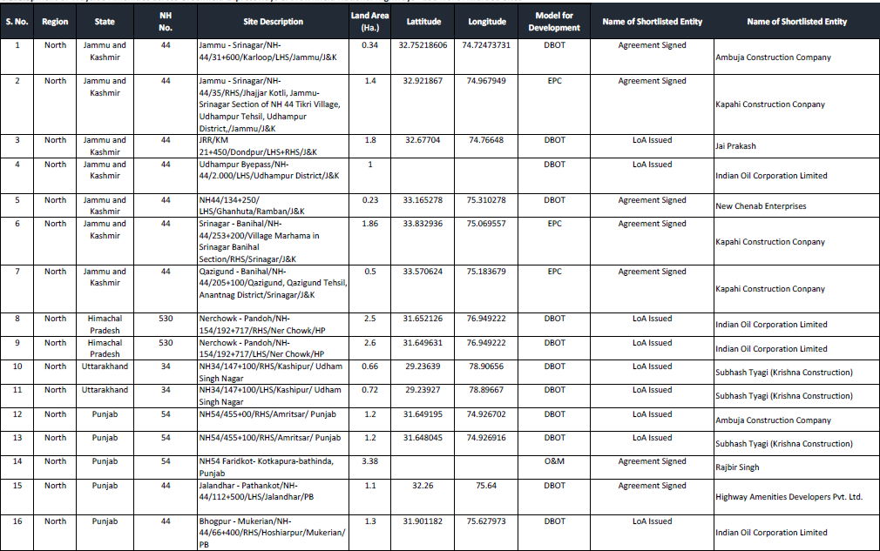
List of Awarded Way Side Amenity Sites (1/8)

Slide 26
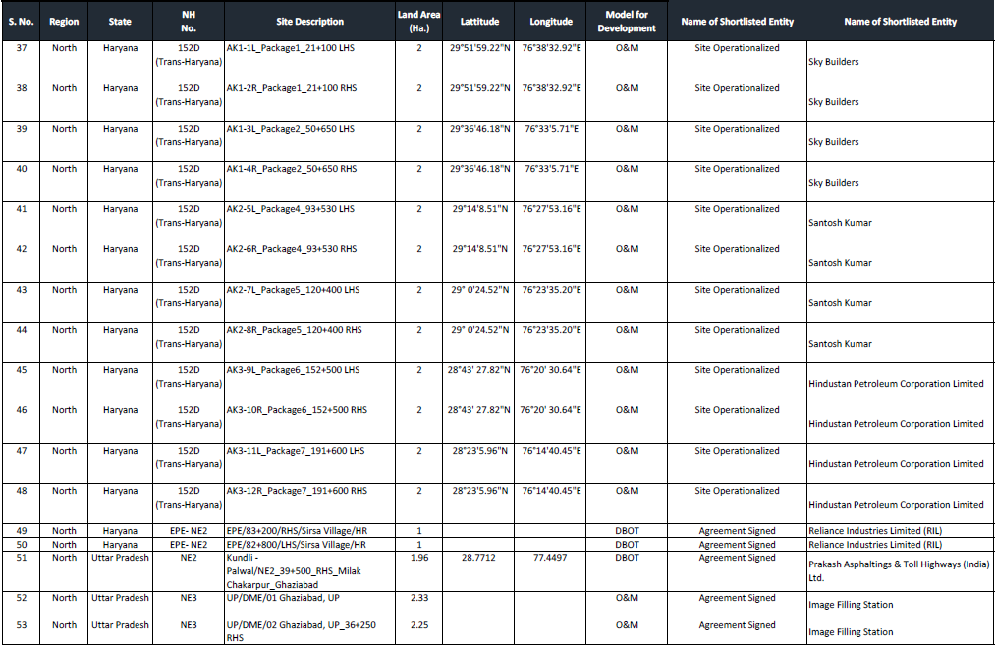
List of Awarded Way Side Amenity Sites (2/8)

Slide 27
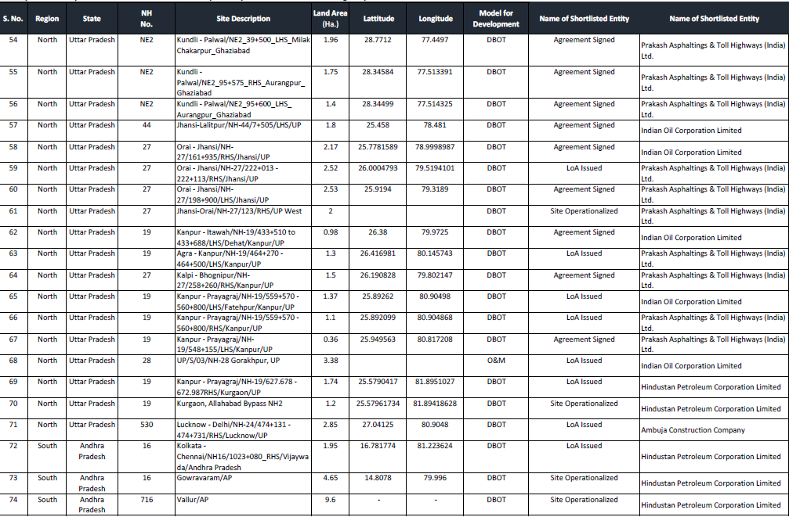
List of Awarded Way Side Amenity Sites (3/8)

Slide 28
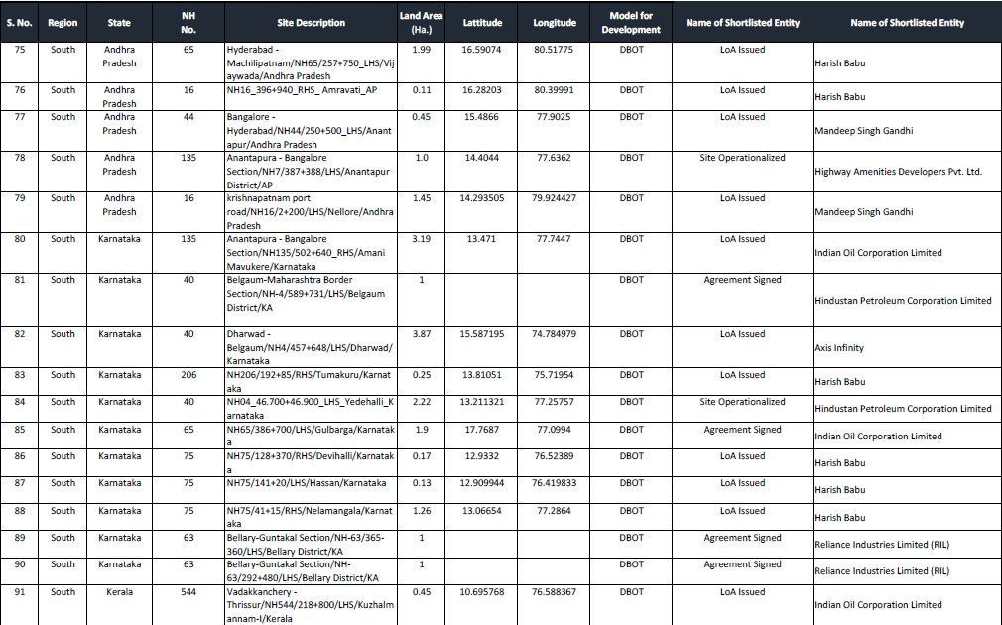
List of Awarded Way Side Amenity Sites (4/8)

Slide 29
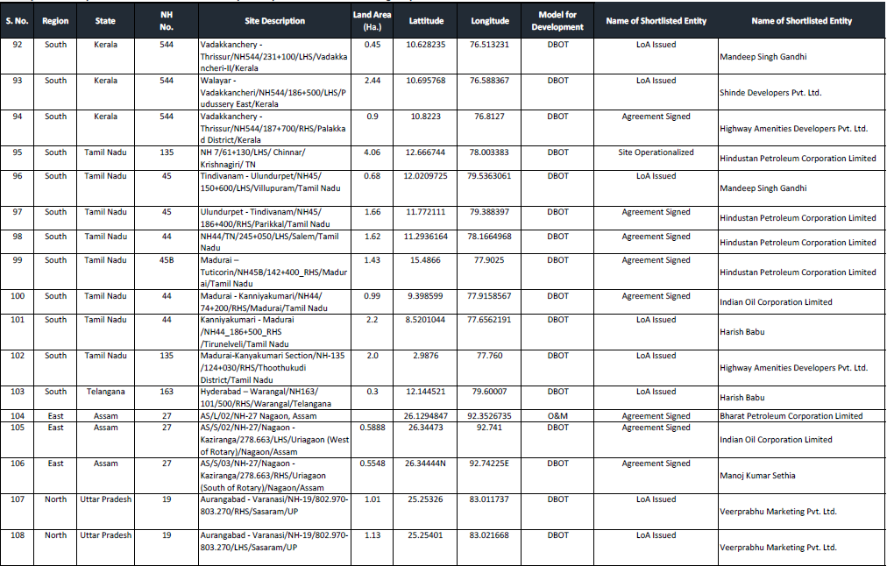
List of Awarded Way Side Amenity Sites (5/8)

Slide 30
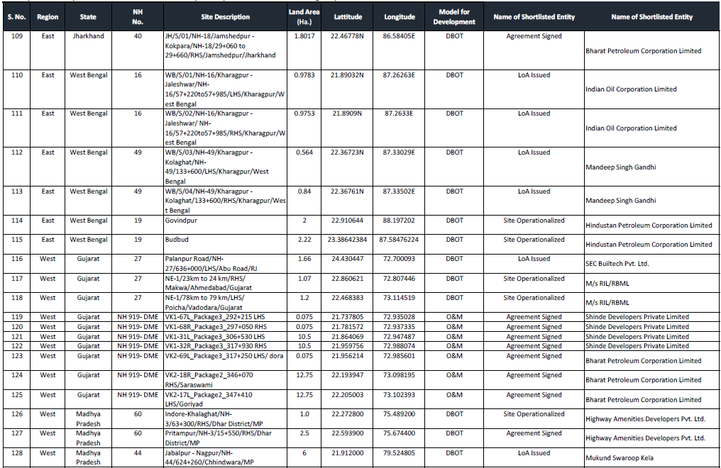
List of Awarded Way Side Amenity Sites (6/8)

Slide 31
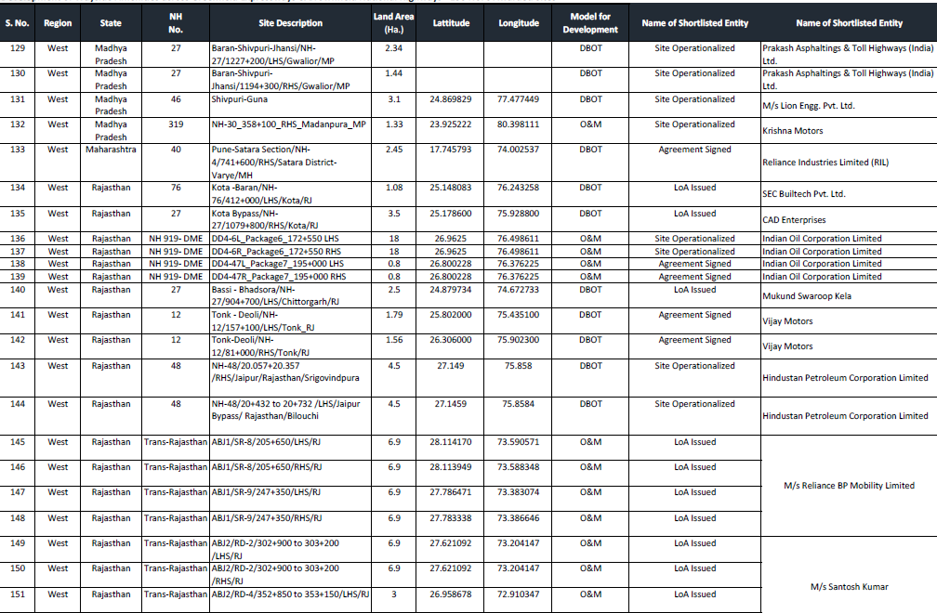
List of Awarded Way Side Amenity Sites (7/8)

Slide 32
List of Awarded Way Side Amenity Sites (8/8)

Slide 33
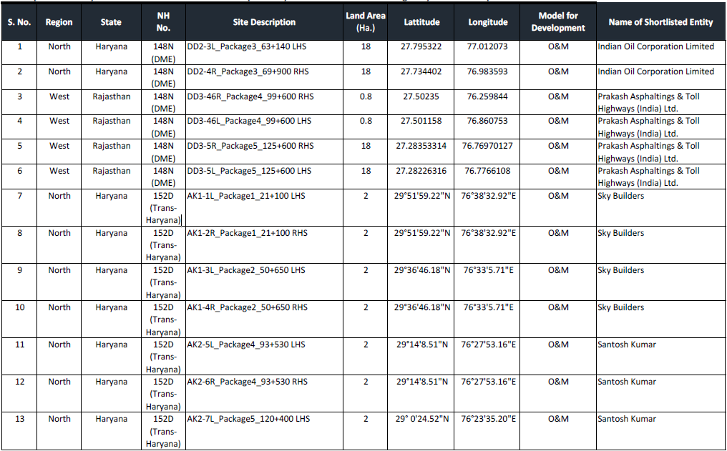
List of Operationalized Way Side Amenities (1/3)

Slide 34
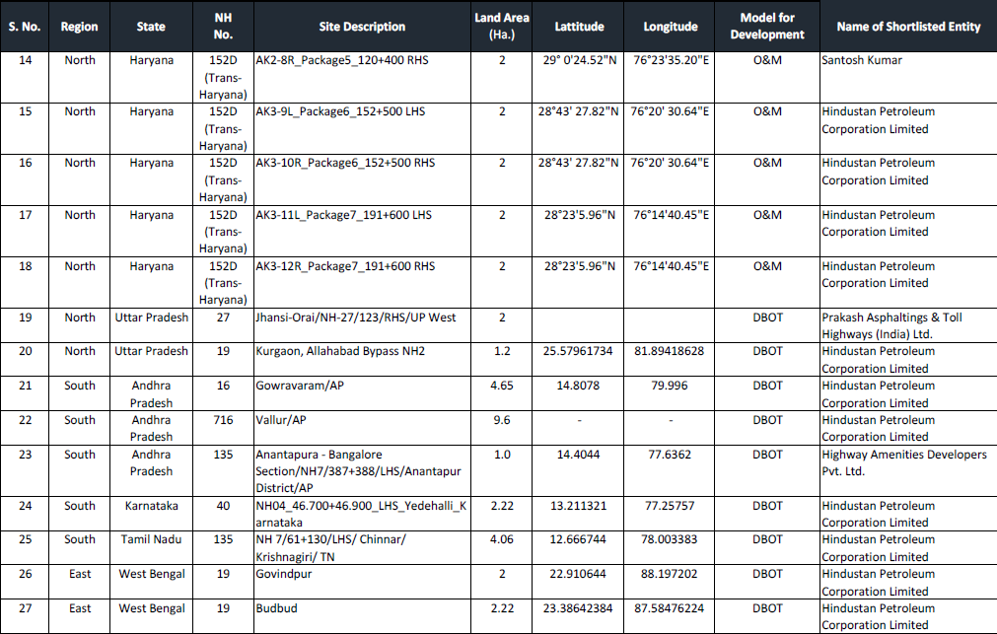
List of Operationalized Way Side Amenities (2/3)

Slide 35
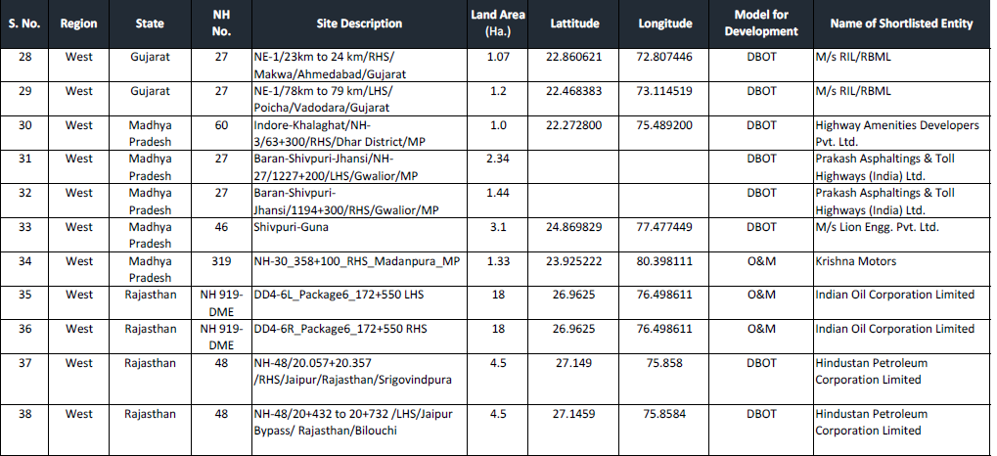
List of Operationalized Way Side Amenities (3/3)

Slide 36
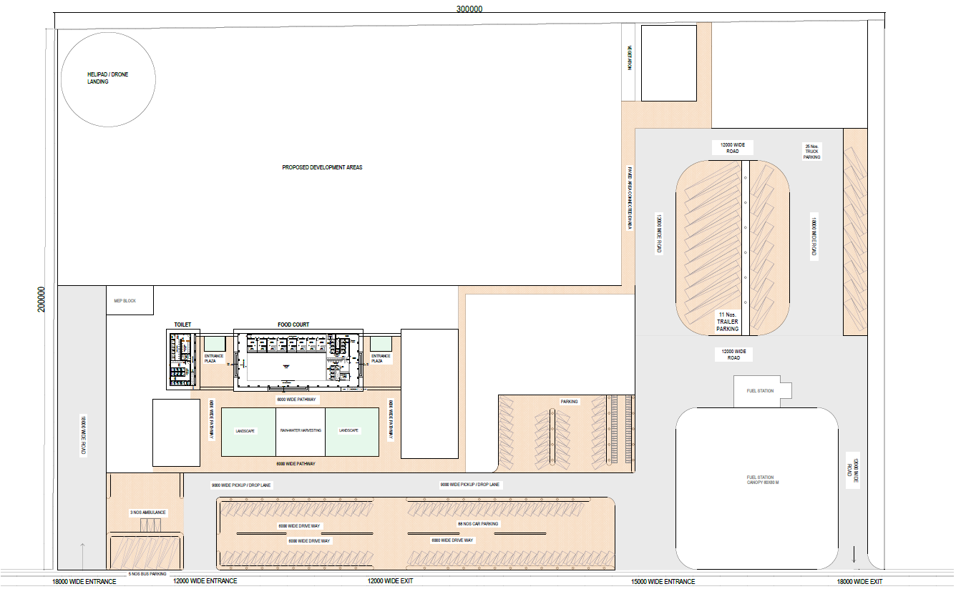
Standard Layout Plans designed for Wayside Amenities – 6 Ha.
Site Details:
Area: 6 Ha.
Frontage: 300 M.
Depth: 200 M.
Built-Up Area: 1,135 Sq. M.
Food Court: 950 Sq. M.
Toilet: 185 Sq. M.
Site Development Area
Roads
Waterbody
Plaza
Paved Parking
Landscape
Parking Facility Details
Car: 88 Nos.
Bus: 5 Nos.
Ambulance: 3 Nos.
Truck: 25 Nos.
Trailer: 11 Nos.
FOOD COURT
TRAILER PARKING
PARKING
TOILET
FUEL STATION
CAR PARKING

Slide 37
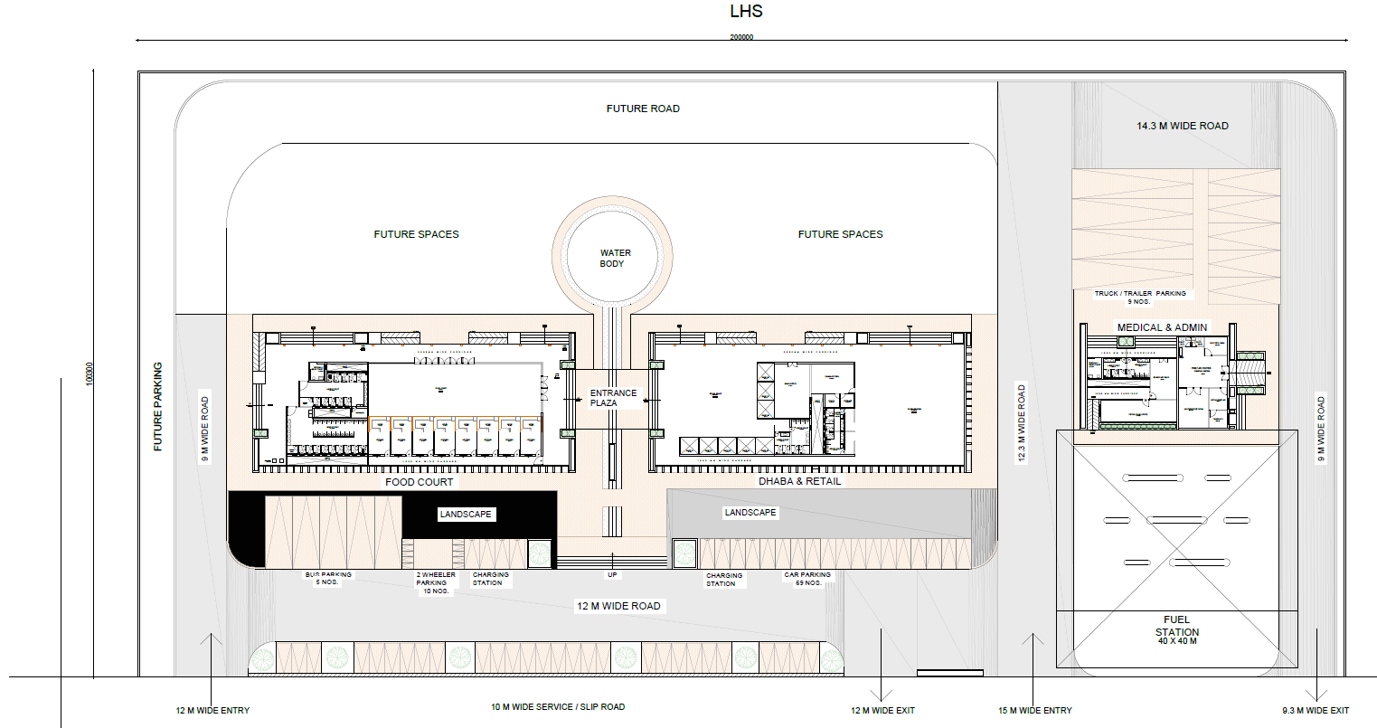
Standard Layout Plans designed for Wayside Amenities – 2 Ha.
Site Details:
Area: 2 Ha.
Frontage: 200 M.
Depth: 100 M.
Built-Up Area: 2,989 Sq. M.
Food Court: 1223 Sq. M.
Dhaba & Retail: 1222 Sq. M.
Medical, Admin: 453 Sq. M.
Site Development Area
Roads
Waterbody
Entrance Plaza
Paved Parking
Landscape
Parking Facility Details
Car: 69 Nos.
Bus: 5 Nos.
Truck/Trailer: 9 Nos.
MEDICAL CENTRE
MEDICAL CENTRE
DHABA
TOILET
MEDICAL CENTRE
DHABA
TOILET
DHABA
TOILET
FOOD COURT
DHABA
TOILET
CHARGING STATION
CHARGING STATION
PARKING
PARKING
FUEL STATION

Slide 38
Bidding Parameters for Award/Development of Site
A. Land Parcels on Brownfield National Highways: Area less than 2 Ha.
Annual Lease Rental
30 Years
Unconstructed Site
15 Years
Constructed Site
Bidding Parameter
Duration of Lease
B. Land Parcels on Brownfield National Highways: Area more than 2 Ha.
Annual Lease Rental + Revenue Sharing %
30 Years
Unconstructed Site
15 Years
Constructed Site
Bidding Parameter
Duration of Lease
C. Land Parcels on Greenfield Access-controlled Expressways
Annual Lease Rental + Revenue Sharing %
30 Years
Unconstructed Site
15 Years
Constructed Site
Bidding Parameter
Duration of Lease

